Slide 1
Build Real-Time, Unified Data Products for Agentic AI with SAP Reltio
Sriraj Rajaram, SAP Reltio
Christian Altmoos, SAP
Arne Ludwig, SAP
Richard Mooney, SAP
October 2026

Slide 2
Agenda
01
Introduction to SAP Reltio
A quick overview of the industry leading data unification and context intelligence platform
02
Exercise 0
Logging in to SAP Reltio and understanding the various components
03
Exercise 1
Loading data into SAP Reltio
04
Exercise 2
Searching and accessing data within SAP Reltio
05
Exercise 3
Understanding the data unification process within SAP Reltio – Match, Merge, Survivorship

Slide 3
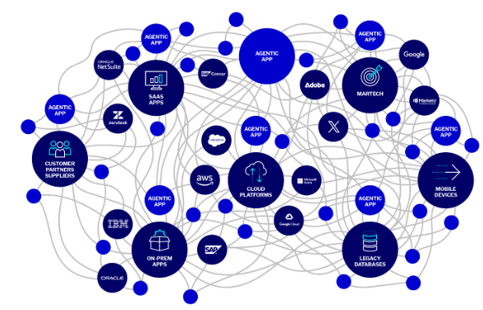



Scattered, Poor Quality Data impeds AI and Agentic benefits
One customer. Hundreds of systems. Many versions.
Website. Store. Mobile Applications. Call center. All disagree on the quality and readiness of data
Same question, asked twice. Same answer, never given.

Slide 4
What bad data actually costs
Ninety-four percent of organizations suspect their own customer and prospect data is inaccurate.
Every one of those records is a place where your team is making decisions — or your AI is taking action — on an incomplete picture.
94
%
Of organizations lack confidence in their data quality

Slide 5
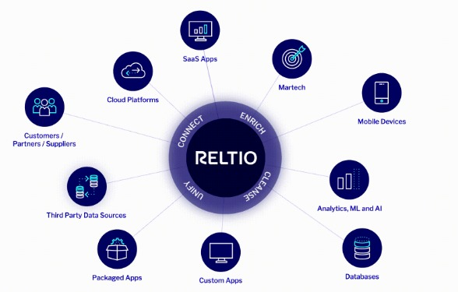
SAP Reltio delivers unified data at scale & speed
Trusted, unified, context-rich profiles
Data governance AI agents
Real-time & ready for operations
Secure, scalable & flexible

Slide 6
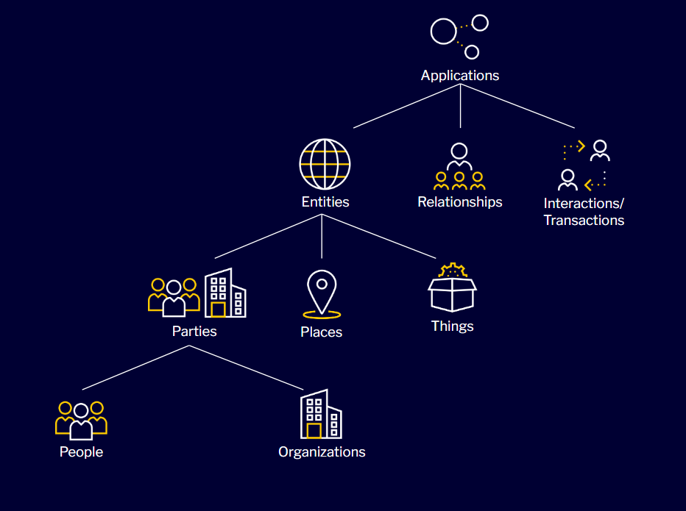



Three types of data – One solution
Entities – These are the core identity asset such as Customers, Employees, Partners, Suppliers etc.
Relationships – Definition of how entities connect to one another such as employer – employee, belongs-to etc.
Interactions – Large volume datasets describing transactions performed by the entity such as purchases, clicks, downloads etc.

Slide 7
SAP Reltio – One Platform, One Agentic Layer
Reltio AgentFlow
Agentic operations suite
Resolver
Unmerger
Enricher
Recommender
Segmenter
Custom Built
Reltio MCP Server
Bridge between data and agents
Reltio Analytical Edition
Reltio Operational Edition
Reltio Business Critical Edition
Bundled features and capabilities
Platform & Infrastructure
Core infrastructure capabilities
Data Graph
Lightspeed
Private Link
Data Model
Integrations
SaaS

Slide 8
SAP Reltio Feature Map is rich and growing
Event
Mgmt.
Private
Link
Data
Cleansing
Relationship
Linking
Security
Mgmt.
Interaction
Mgmt.
Identity
Builder
Data
Ingestion
Data
Modeling
Hierarchy
Mgmt.
Audit
Trail
Data
Sharing
Business
Critical
Data
Enrichment
Match
&
Merge
Reference
Data
Mgmt.
Segmentation
Data Delivery
Network
Reltio
Integration
Hub
Data
Validation
Householding
& Grouping
UI/UX
Data
Export
Data
Survivorship
Data
Graph
Zero Copy Integration
MCP Server
AgentFlow
Data
Governance
APIs
Agent
Marketplace

Slide 9
Getting Started with
SAP Reltio

Slide 10
SAP TechEd 2026 DA160 Focus
Event
Mgmt.
Private
Link
Data
Cleansing
Relationship
Linking
Security
Mgmt.
Interaction
Mgmt.
Identity
Builder
Data
Ingestion
Data
Modeling
Hierarchy
Mgmt.
Audit
Trail
Data
Sharing
Business
Critical
Data
Enrichment
Match
&
Merge
Reference
Data
Mgmt.
Segmentation
Data Delivery
Network
Reltio
Integration
Hub
Data
Validation
Householding
& Grouping
UI/UX
Data
Export
Data
Survivorship
Data
Graph
Zero Copy Integration
MCP Server
AgentFlow
Data
Governance
APIs
Agent
Marketplace

Slide 11
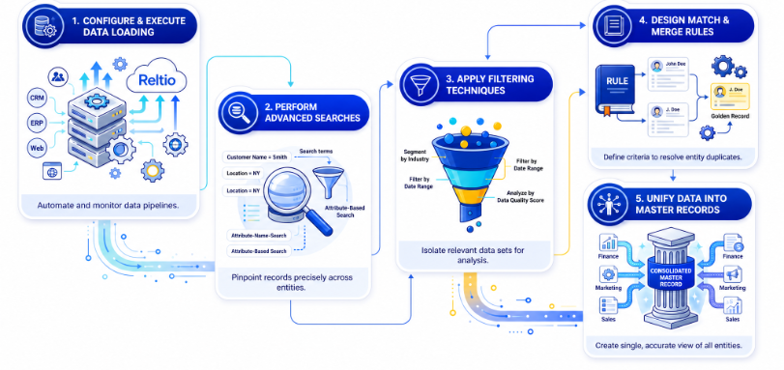

Slide 12
Exercise 0 :
Exploring SAP Reltio

Slide 13
SAP Reltio offers an intuitive User Experience
One customer. Hundreds of systems. Many versions.
Website. Store. Mobile Applications. Call center. All disagree on the quality and readiness of data
Same question, asked twice. Same answer, never given.

Slide 14
Exercise 1 :
Loading Data

Slide 15


Data Loading – An Overview
Data loading is the process of ingesting data from source systems into Reltio platform to create and update entity records. Data can be loaded via APIs, Batch import or the User Interface. When loading data into Reltio, the choice of update strategy determines how existing records are modified. Partial updates only modify attributes explicitly mapped in the load file or input. Full updates overwrite all attributes including unmapped ones.
1
2
Map columns to Reltio attributes
3
Configure load settings
Upload load file
Hands-on exercise – Load a CSV file into a Reltio Entity.
Load SAP_DA160_Orgs.csv to Organization entity

Slide 16
Exercise 2:
Searching Data

Slide 17

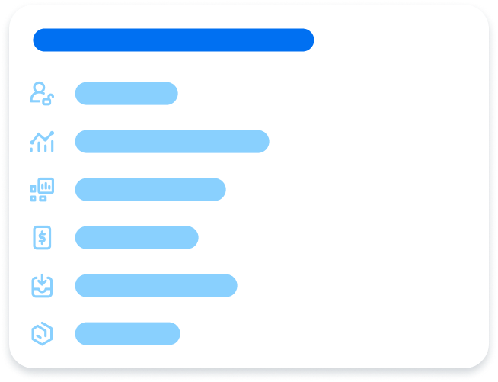

Reltio Search – An Overview
Reltio Search is a powerful, intuitive experience to quickly find, filter and manage entity records and segments. It enables
Fast discovery and management of entity data
Advanced querying with flexible filters
Easy and secure sharing of search results
Left Panel: Comprises of advanced search and quick filters
Top Panel: Load data, save searches and share results
Center Panel: View results as tables, lists or maps

Slide 18
Hands-on Challenge: Build a search query
Can you find an organization:
Whose source system name equals “Finance”
Name contains “lab”
Can you find an organization:
Whose address / state equals “Washington”
Phone formatted number contains “125”
Can you find organizations:
Whose verification status equals Unverified

Slide 19
Exercise 3 :
Data Unification

Slide 20
Understanding SAP Reltio’s Data Unification
Matching: Rule-based control, plus Reltio Flexible Entity Resolution Networks™ (FERN) for LLM-powered matching at scale
Survivorship: The best, most trustworthy value from every source wins the golden record
Reltio ID: One persistent identifier per entity, for life
Source = Customer Service
ID: 45GBh8K
John Smith
Shipping Address
100 Main Street, Suite 100
San Francisco, CA 94105
Phone – (415) 555-1212
Merged Record
Reltio ID: 4bii9K
John L. Smith
Male
Income: USD 150K
Shipping Address
100 Main Street, Suite 100
San Francisco, CA 94105
Phone – (415) 555-1212
Billing Address
P.O. Box 1234
San Francisco, CA 94015
jlsmith@email.com
CrossWalk IDs:
Customer Service - 45GBh8K
Marketing – 880920172
Finance - A009872
Source = Marketing
ID: 880920172
J.L. Smith
Male
Shipping Address
100 Main Street, Suite 100
San Francisco, CA 94105
Income: USD $150K
(415) 555-1212
jlsmith@email.com
Source = Finance
ID: A009872
John Smith
Shipping Address
100 Main Street
San Francisco, CA 94105
Billing Address
P.O. Box 1234
San Francisco, CA 94015

Slide 21
SAP Reltio Match Engine
 |  | Reality
 |  | Match | Not a Match
Match Engine | Match | True Positive: Engine = Reality | False Positive: Engine incorrectly matched
 | Potential Match | Data Steward Evaluation
 | Not a Match | False Negative: Engine incorrectly missed a match | True Negative: Engine = Reality
The match engine is the intelligence behind identifying duplicates and creating a trusted combined profile. The match engine
Identifies duplicate entities across disparate data sources
Determines which records represent the same real-world person, organization or object
Resolves fragmented data into a combined unified profile
Human review is needed when
Records are flagged as potential matches by engine
Profiles are involved in manual merge or unmerge actions
Exception where automated rules require human judgement

Slide 22
SAP Reltio Match Engine – Decision Matrix
 |  | Reality
 |  | Match | Not a Match
Match Engine | Match | True Positive: Engine = Reality | False Positive: Engine incorrectly matched
 | Potential Match | Data Steward Evaluation
 | Not a Match | False Negative: Engine incorrectly missed a match | True Negative: Engine = Reality
 | 1.0
Automatic Merge | 0.9
 | 0.8
Potential Match | 0.7
 | 0.6
 | 0.5
Not a match | 0.4
 | 0.3
 | 0.2
 | 0.1
 | 0.0

Slide 23
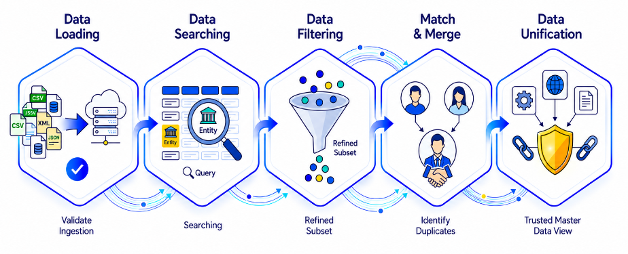
Review of the Workshop

Slide 24
Join the conversation
You ask. We answer.

Slide 26
Text with icons
Learning
Innovation
Culture
Elitr, sed diam nonumy eirmod tempor invidunt ut labore et dolore magna aliquyam erat, sed diam voluptua. At vero eos et accusam et justo duo dolores et ea rebum.
Elitr, sed diam nonumy eirmod tempor invidunt ut labore et dolore magna aliquyam erat, sed diam voluptua. At vero eos et accusam et justo duo dolores et ea rebum.
Elitr, sed diam nonumy eirmod tempor invidunt ut labore et dolore magna aliquyam erat, sed diam voluptua. At vero eos et accusam et justo duo dolores et ea rebum.
Benefits
Goals
Lesson learned
Elitr, sed diam nonumy eirmod tempor invidunt ut labore et dolore magna aliquyam erat, sed diam voluptua. At vero eos et accusam et justo duo dolores et ea rebum.
Elitr, sed diam nonumy eirmod tempor invidunt ut labore et dolore magna aliquyam erat, sed diam voluptua. At vero eos et accusam et justo duo dolores et ea rebum.
Elitr, sed diam nonumy eirmod tempor invidunt ut labore et dolore magna aliquyam erat, sed diam voluptua. At vero eos et accusam et justo duo dolores et ea rebum.
Use icons in Indigo for content that’s related to AI/Joule

Slide 27
Roadmap
<Project or program name> – program road map
Q1/2026
Q2/2026
Q3/2026
Q4/2026
0
1
2
3
Program initiation and ramp-up
Solution design phase
Implementation phase
Rollout phase
xx: 1st steering committee
xx: Kickoff
Analysis
Blueprinting
Design and technical feasibility
Implementation
Testing
Q-Gates, Steering Committee Decisions
Rollout
xx: Rollout finalized

Slide 28
Table – four columns
Lorem | Ipsum | Dolor | Sit
Test table content | Test table content | Test table content | Test table content
Test table content | Test table content | Test table content | Test table content
Test table content | Test table content | Test table content | Test table content
Test table content | Test table content | Test table content | Test table content
Test table content | Test table content | Test table content | Test table content

Slide 29
Diagram with icons
Manage
situation objects
Manage
teams and responsibilities
Situation handling
demo
Notification
(optional)
Situation
Recipients
Manage
situation scenarios
Manage
situation types – extended
My situations – extended
Use icons in Indigo for content that’s related to AI/Joule

